Slide 1

Notes:
1
Good morning. Welcome to your training on Advanced Selenium Automation, delivered by NobleProg
NobleProg has been in training and consultancy for more than 12 years, with offices across 13 countries and over 500 trainers in different fields of expertise. We have served more than 5000 companies with over 46,000 satisfied delegates

Slide 2
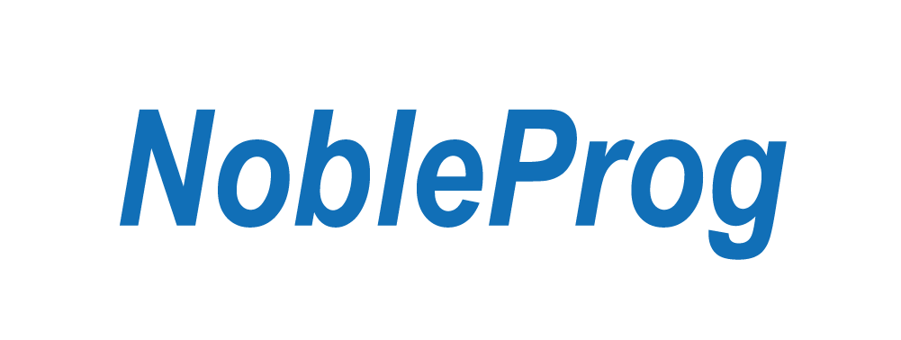
Deploying Kubernetes Applications with Helm Training Course
Trainer – Kumbulani Conrad Tshuma
Notes:
2

Slide 3
Introduction
Helm is a powerful package manager for Kubernetes, which simplifies the deployment and management of applications within Kubernetes clusters. Leveraging Helm for CI/CD processes can streamline application updates, improve deployment consistency, and enhance overall productivity.

Slide 4
Helm package manager as a Continuous Integration (CI) / Continous Deployment (CD) tool
Benefits of Using Helm in CI/CD
Declarative Management: Helm uses declarative configuration files (Chart.yaml and templates) that can be version-controlled, ensuring repeatable and consistent deployments.
Versioning and Rollbacks: Helm keeps track of release versions, allowing easy rollbacks to previous application states if something goes wrong.
Modularity: Helm Charts enable the packaging of applications and dependencies into modular and reusable units, simplifying complex deployments.
Environment Configuration: Helm supports environment-specific configurations through values files, enabling tailored deployments for development, staging, and production environments.

Slide 5
Helm package manager as a Continuous Integration (CI) / Continous Deployment (CD) tool
Best Practices for Using Helm in CI/CD
Use Stable and Tested Charts: Ensure Helm charts are stable and tested before integrating them into the CI/CD pipeline.
Environment Isolation: Use separate Kubernetes namespaces or clusters for different environments (development, staging, production) to avoid conflicts.
Automated Rollbacks: Implement automated rollback strategies to handle failed deployments gracefully.
Security: Secure Helm repositories and CI/CD pipelines to prevent unauthorized access and modifications.
Monitoring and Logging: Integrate monitoring and logging solutions to track the health and performance of deployed applications.

Slide 6
Helm package manager as a Continuous Integration (CI) / Continous Deployment (CD) tool
Example CI/CD Workflow with Helm
Code Changes: Developer pushes code changes to the repository.
CI Process:
Run linting and validation of Helm charts.
Perform unit tests on Helm templates.
Packaging: Package the Helm chart and update the Helm repository.
CD Process:
Deploy the Helm chart to the target Kubernetes environment.
Monitor the deployment for issues and perform rollbacks if necessary.

Slide 7
Helm package manager as a Continuous Integration (CI) / Continous Deployment (CD) tool
Install Docker
Kubernetes uses Docker as its container runtime. Install Docker using the following commands:
sudo apt-get install -y apt-transport-https ca-certificates curl software-properties-common
curl -fsSL https://download.docker.com/linux/ubuntu/gpg | sudo apt-key add -
sudo add-apt-repository "deb [arch=amd64] https://download.docker.com/linux/ubuntu $(lsb_release -cs) stable"
sudo apt-get update
sudo apt-get install -y docker-ce
sudo systemctl enable docker
sudo systemctl start docker
Download Minikube:
curl -LO https://storage.googleapis.com/minikube/releases/latest/minikube-linux-amd64
sudo install minikube-linux-amd64 /usr/local/bin/minikube

Slide 8
Helm package manager as a Continuous Integration (CI) / Continous Deployment (CD) tool
Download and Install Kubectl:
curl -LO "https://dl.k8s.io/release/$(curl -s https://storage.googleapis.com/kubernetes-release/release/stable.txt)/bin/linux/amd64/kubectl"
chmod +x kubectl
sudo mv kubectl /usr/local/bin/
Start Minikube with Docker Driver:
minikube start --driver=docker
Download and Install Helm:
curl https://baltocdn.com/helm/signing.asc | sudo apt-key add -
sudo apt-get install apt-transport-https --yes
echo "deb https://baltocdn.com/helm/stable/debian/ all main" | sudo tee /etc/apt/sources.list.d/helm-stable-debian.list
sudo apt-get update
sudo apt-get install helm

Slide 9
Kubernetes Cluster Architecture and Docker
Docker Overview
Docker is a platform for developing, shipping, and running applications using containerization. Containers are lightweight, standalone, and executable packages that include everything needed to run a piece of software, including the code, runtime, libraries, and dependencies. Docker containers are based on images, which are read-only templates containing the instructions for creating a container.
Key Docker Concepts:
Docker Image: A read-only template used to create containers.
Docker Container: An instance of a Docker image that runs a specific application or process.
Dockerfile: A text file that contains instructions for building a Docker image.
Docker Registry: A repository for storing and distributing Docker images (e.g., Docker Hub).

Slide 10
Kubernetes Cluster Architecture and Docker
Kubernetes Overview
Kubernetes is an open-source container orchestration platform that automates the deployment, scaling, and management of containerized applications. It allows you to deploy your applications quickly and efficiently, scaling them up or down based on demand, and ensures that your applications are always available.
Key Kubernetes Concepts:
Node: A physical or virtual machine that serves as a worker in a Kubernetes cluster.
Pod: The smallest deployable unit in Kubernetes, representing a single instance of a running process.
Deployment: A Kubernetes resource that defines how many replicas of a pod should be running at any given time.
Service: A Kubernetes resource that exposes a set of pods to other parts of the cluster or the outside world.

Slide 11
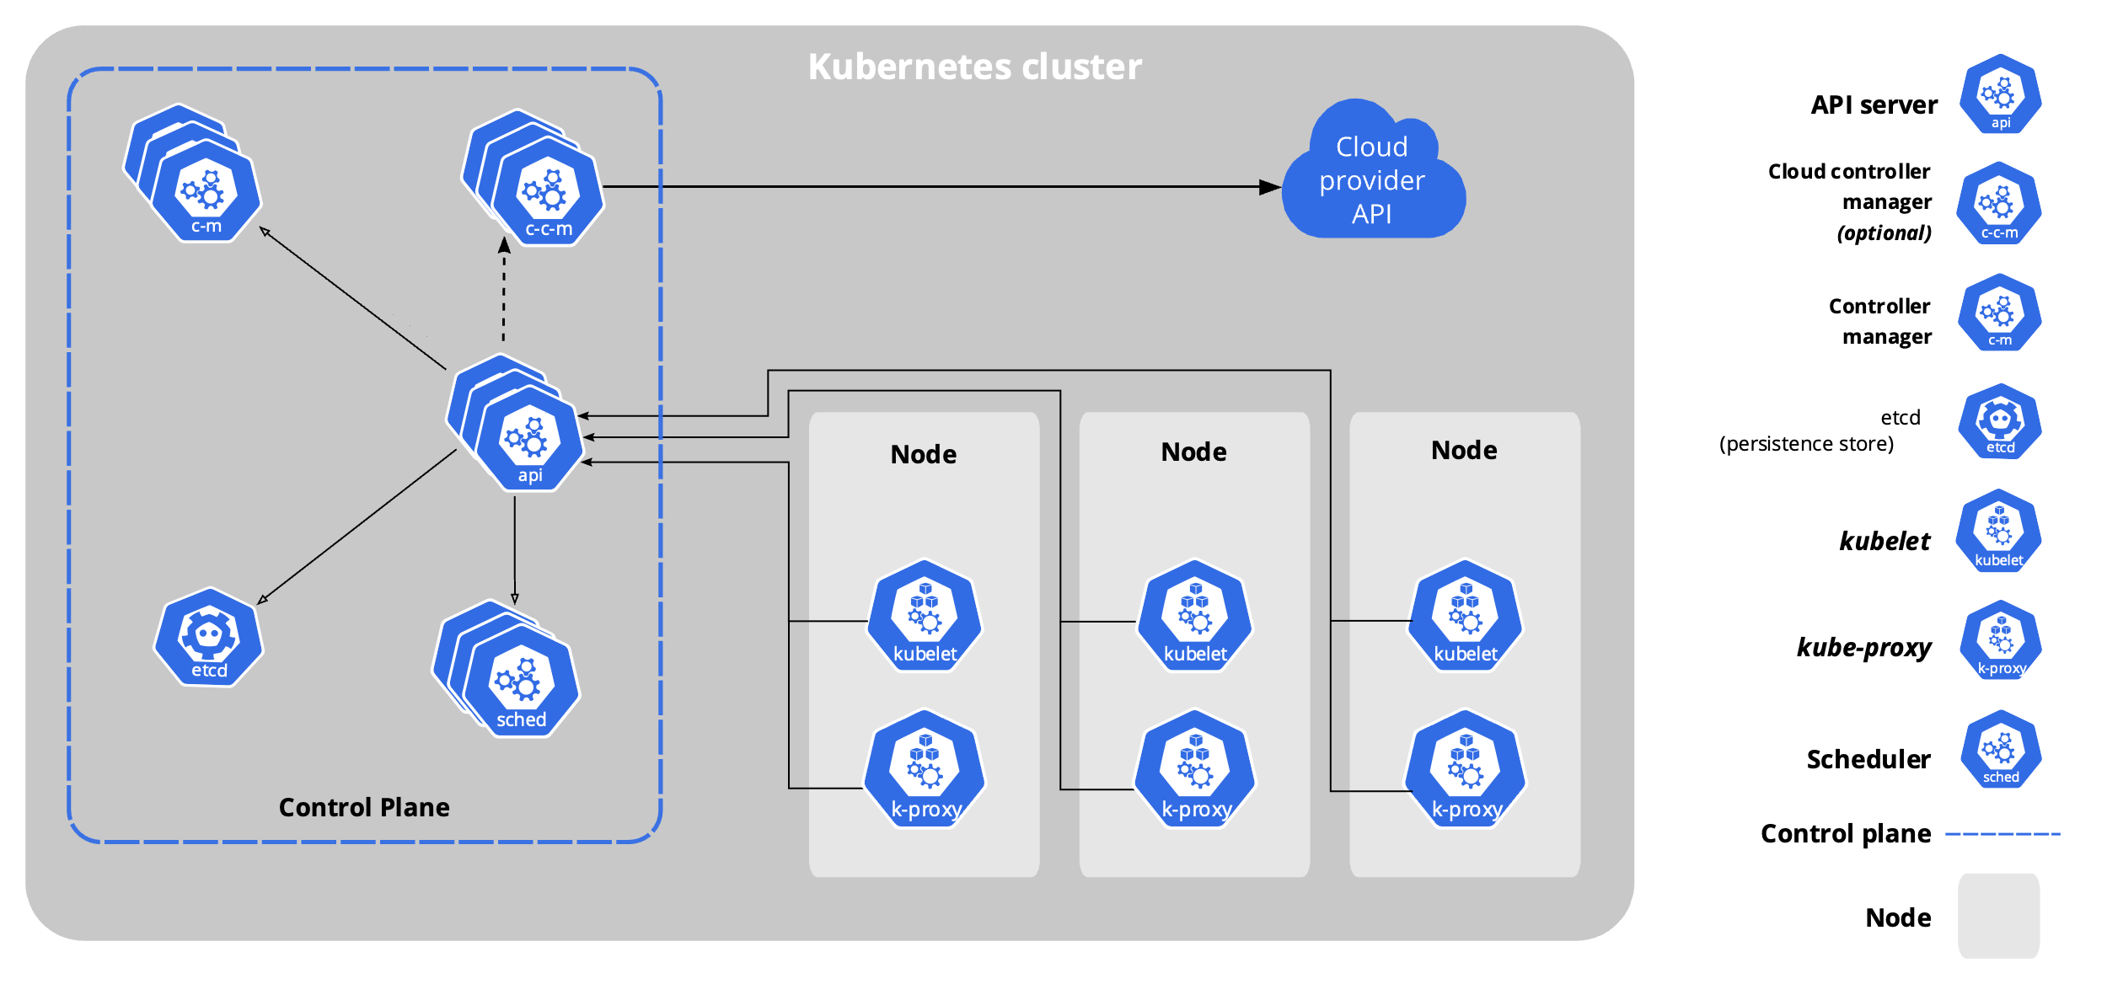
Kubernetes Cluster Architecture and Docker

Slide 12
Kubernetes Cluster Architecture and Docker
Kubernetes Cluster Architecture
A Kubernetes cluster consists of several components that work together to manage the lifecycle of your applications. Some of the key components include:
Control Plane Components:
kube-apiserver: Exposes the Kubernetes API and serves as the front-end for the Kubernetes control plane.
etcd: A distributed key-value store used to store cluster data, including configuration and state.
kube-scheduler: Assigns pods to nodes based on resource availability and other constraints.
kube-controller-manager: Manages various controllers that regulate the state of the cluster.
Node Components:
kubelet: An agent that runs on each node and is responsible for managing pods and their containers.
kube-proxy: Maintains network rules on nodes and enables communication between pods across the cluster.
Container Runtime: The software that runs containers, such as Docker or containerd.

Slide 13
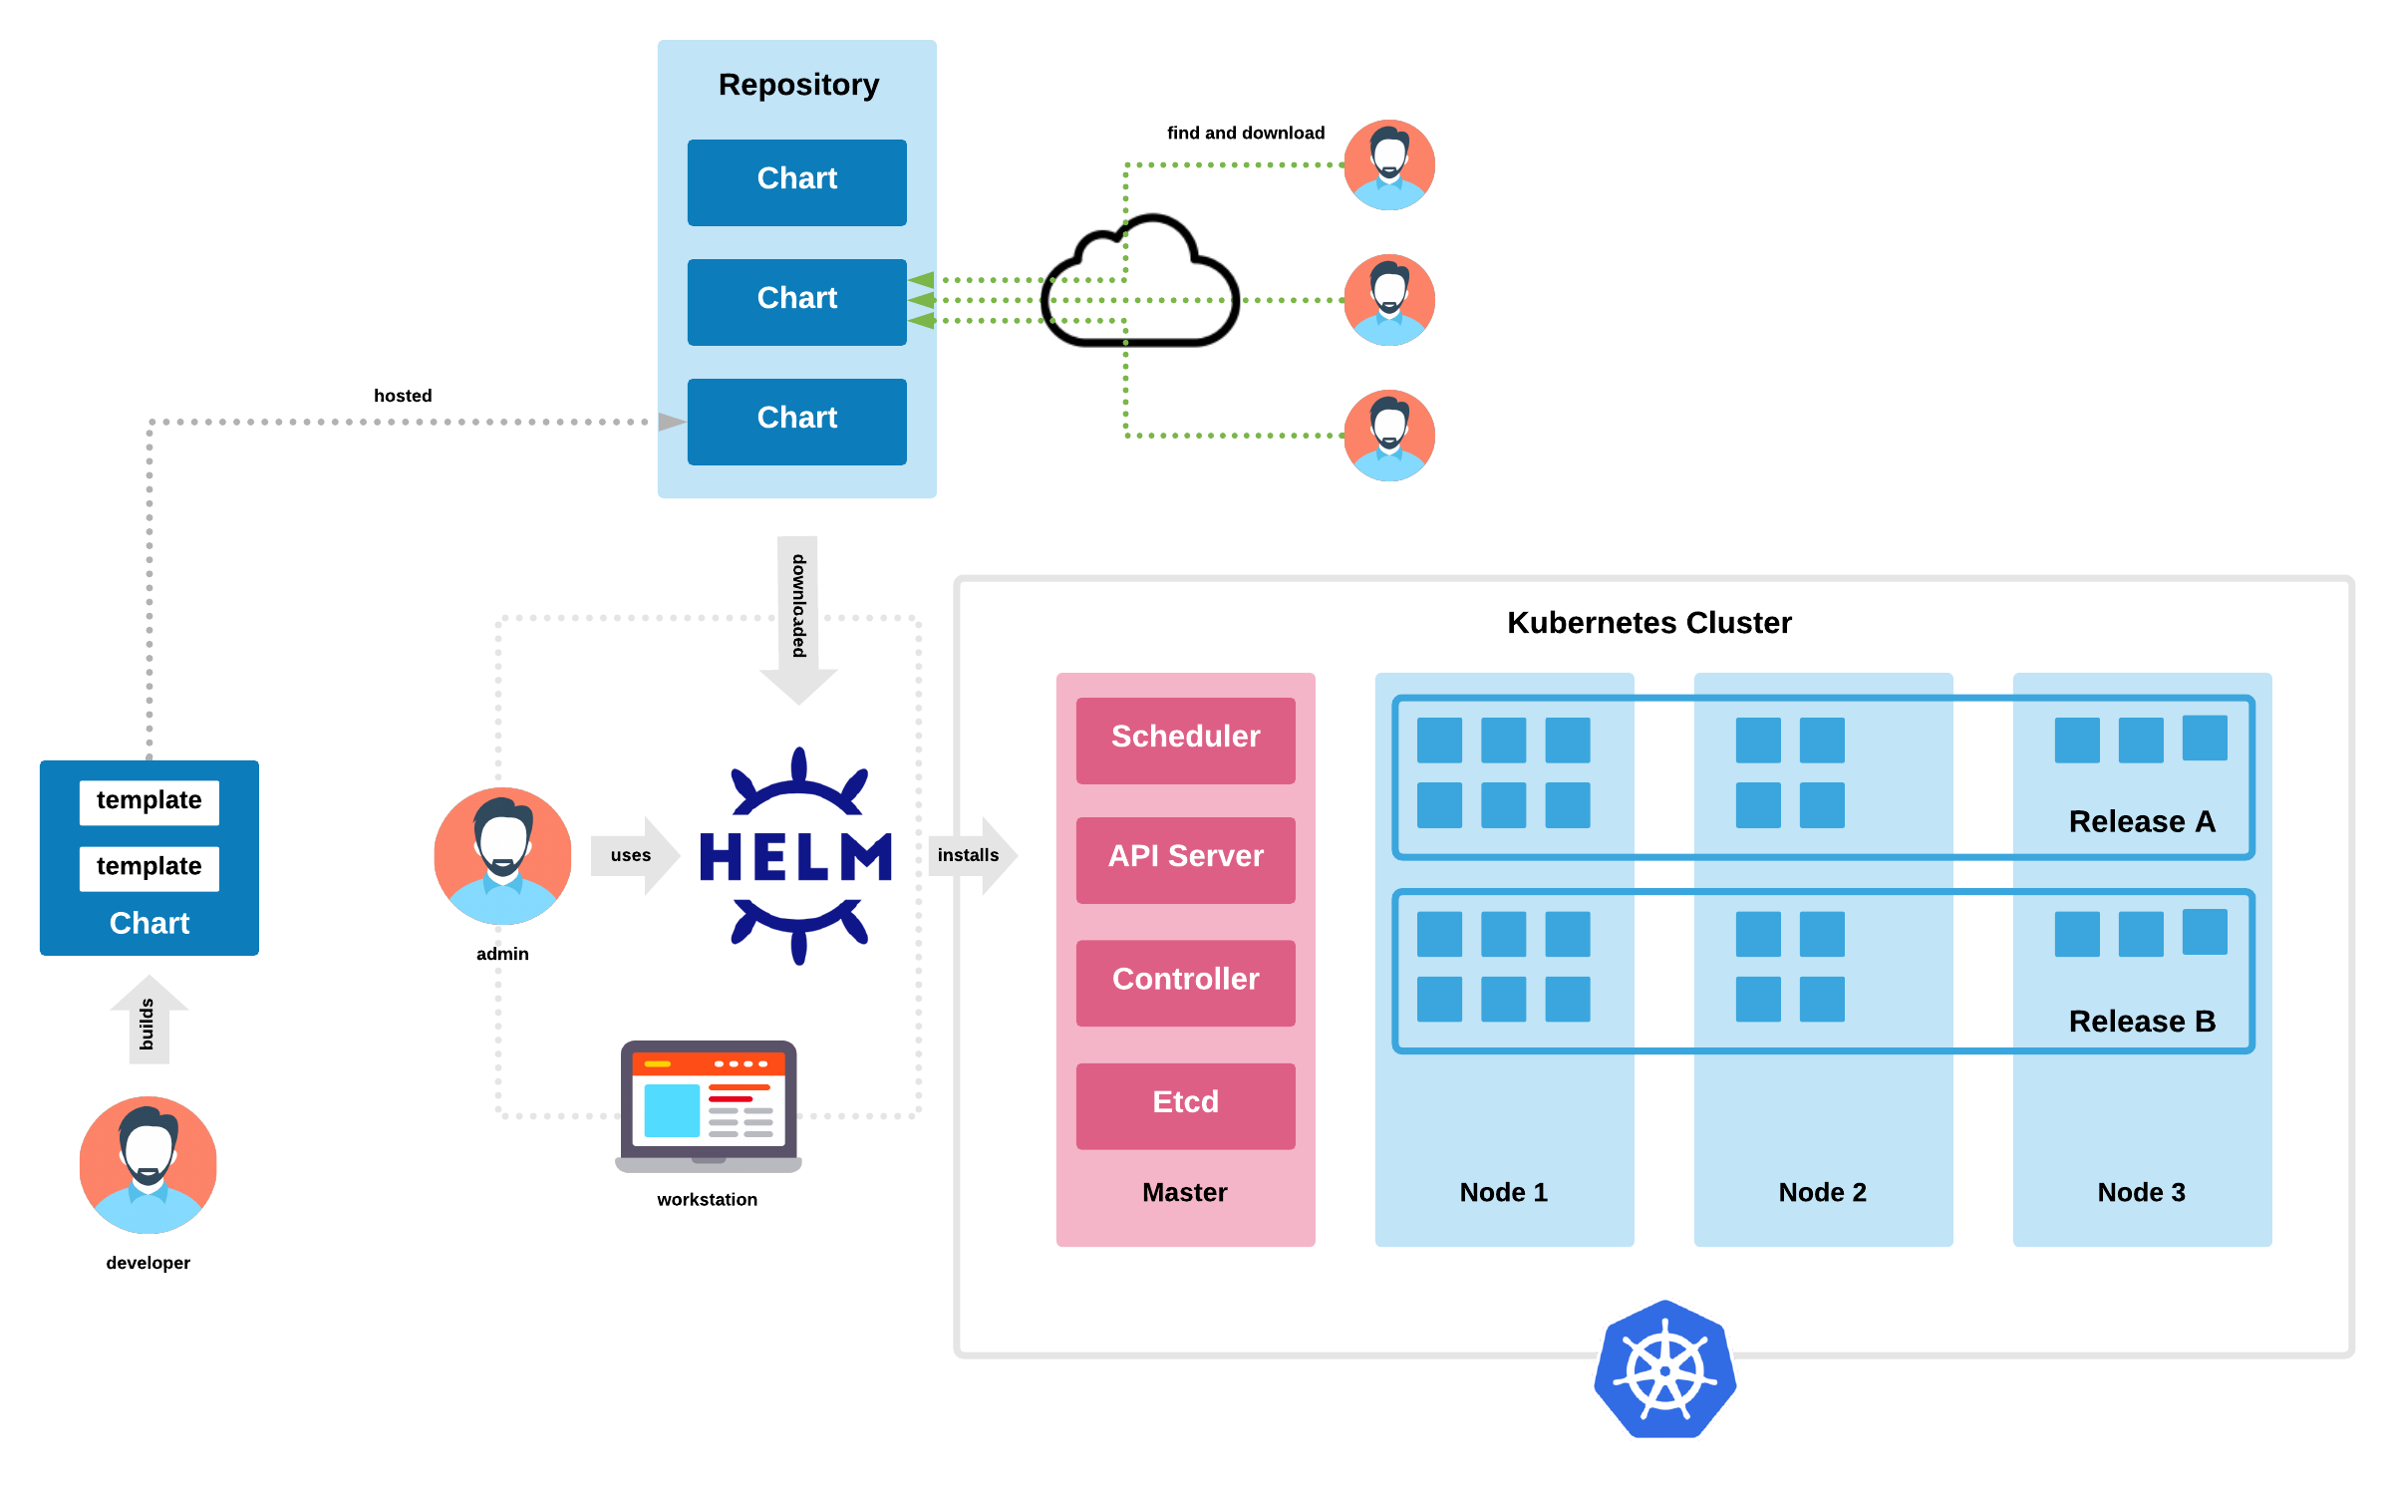
Overview of Helm Features and Architecture

Slide 14
Overview of Helm Features and Architecture
Key Features of Helm
Charts: Packages of pre-configured Kubernetes resources that can be easily shared and reused.
Templates: Allows you to use Go templates to customize Kubernetes resource definitions.
Dependencies: Supports dependencies between charts, making it easy to manage complex applications.
Release Management: Tracks releases of applications, making it easy to roll back to previous versions.
Hooks: Allows you to run scripts at various points during the lifecycle of a chart (e.g., before installation, after deletion).
Repositories: Supports multiple repositories for storing and sharing charts.

Slide 15
Overview of Helm Features and Architecture
Helm Architecture
Client: The Helm command-line interface (CLI) that allows you to interact with the Helm server and manage charts.
Server (Tiller): Deprecated in Helm v3. Tiller was the server-side component of Helm responsible for managing the lifecycle of charts. It interacted with the Kubernetes API server to install, upgrade, and delete charts. In Helm v3, Tiller has been removed, and Helm now interacts directly with the Kubernetes API server.
Chart Repository: A repository that stores Helm charts. Helm can install charts from a variety of repositories, including the official Helm Hub and custom repositories.
Kubernetes API Server: The central component of a Kubernetes cluster that stores the cluster state and manages the lifecycle of Kubernetes resources.
Kubectl: The Kubernetes command-line tool used to interact with the Kubernetes API server. Helm uses kubectl to deploy and manage Kubernetes resources.

Slide 16
Navigating the Kubernetes Dashboard and Helm CLI
Install the Kubernetes Dashboard
Deploy the Dashboard:
kubectl apply -f https://raw.githubusercontent.com/kubernetes/dashboard/v2.0.0/aio/deploy/recommended.yaml
Create a ClusterRoleBinding:
kubectl create clusterrolebinding dashboard-admin-sa \
--clusterrole=cluster-admin \
--serviceaccount=kubernetes-dashboard:kubernetes-dashboard
Get the Dashboard URL:
minikube dashboard --url
Access the Dashboard:
Open the URL in your web browser to access the Kubernetes Dashboard. You may be prompted to log in; use the token method and enter the token printed by the following command:
kubectl -n kubernetes-dashboard describe secret $(kubectl -n kubernetes-dashboard get secret | grep kubernetes-dashboard | awk '{print $1}')

Slide 17
Create helm chart
Create a New Chart
Use the Helm CLI to create a new chart. Replace mychart with the name of your chart:
helm create mychart
mychart/
├── charts/
├── Chart.yaml
├── templates/
│ ├── deployment.yaml
│ ├── _helpers.tpl
│ ├── hpa.yaml
│ ├── ingress.yaml
│ ├── NOTES.txt
│ ├── serviceaccount.yaml
│ ├── service.yaml
│ └── tests/
│ └── test-connection.yaml
└── values.yaml

Slide 18
Create helm chart
Define Chart Metadata
Edit the Chart.yaml file to define metadata for your chart, such as the name, description, version, and dependencies:
apiVersion: v2
name: mychart
description: A Helm chart for my application
type: application
version: 0.1.0
appVersion: 1.0.0
Define Chart Templates
Edit the files in the templates/ directory to define Kubernetes manifests for your application. Use Go templates to customize the manifests based on values defined in values.yaml.

Slide 19
Create helm chart
Define Default Values
Edit the values.yaml file to define default values for your application's configuration:
replicaCount: 1
image:
repository: nginx
tag: stable
pullPolicy: IfNotPresent
service:
name: my-service
type: ClusterIP
port: 80
Package the Chart
Package your chart using the helm package command:
helm package mychart

Slide 20
Create helm chart
Create a Repository
You can use any web server to host your Helm repository. Here's an example of how you can set up a basic repository using a local directory and Python's SimpleHTTPServer module:
Create a directory to serve as your repository:
mkdir /path/to/repo
Copy your packaged chart (.tgz file) into the repository directory:
cp mychart-0.1.0.tgz /path/to/repo
Change into the repository directory and start a simple HTTP server:
cd /path/to/repo
python -m SimpleHTTPServer 8000
Add the Repository to Helm
Once your repository is set up and running, you can add it to Helm:
helm repo index /path/to/repo --url http://localhost:8000
This command creates or updates an index.yaml file in your repository directory, which Helm uses to track the available charts in the repository.

Slide 21
Create helm chart
Use Your Repository
Now that your repository is set up and indexed, you can use it to install your chart:
helm repo add myrepo http://localhost:8000
helm repo update
helm search repo myrepo
helm install mychart myrepo/mychart

Slide 22
Deploying a Kubernetes Application
Deploy the Helm Chart
Use the helm install command to deploy the Helm chart. Replace mychart with the name of your chart, and my-release with the name you want to give to your release:
helm install my-release mychart
Verify the Deployment
Check the status of your deployment to verify that it was successful:
kubectl get deployments
kubectl get pods
kubectl get services
Manage Your Deployment
You can manage your deployment using Helm commands. For example, to upgrade your deployment to a new version of the chart:
helm upgrade my-release mychart
uninstall the deployment:
helm uninstall my-release

Slide 23
Mnaging the application
Upgrade a Release
To upgrade a release to a new version of the chart or with new configuration values, use the helm upgrade command. Replace my-release with the name of your release and mychart with the name of your chart:
helm upgrade my-release mychart
Rollback a Release
If an upgrade causes issues, you can rollback to a previous version of the release using the helm rollback command. Replace my-release with the name of your release and <revision> with the revision number you want to rollback to:
helm rollback my-release <revision>
List Releases
You can list all deployed releases and their statuses using the helm list command:
helm list
Uninstall a Release
To uninstall a release and delete all resources associated with it, use the helm uninstall command:
helm uninstall my-release
View Release History
To view the history of a release, including previous upgrades and rollbacks, use the helm history command:
helm history my-release

Slide 24
Managing the application
Specify Namespace for a Release
To deploy a release to a specific namespace, use the --namespace flag with the helm install or helm upgrade commands:
helm install my-release mychart --namespace my-namespace
List Releases in a Namespace
To list all releases in a specific namespace, use the --namespace flag with the helm list command:
helm list --namespace my-namespace
Delete Releases in a Namespace
To uninstall all releases in a specific namespace, you can use a simple script with the helm list and helm uninstall commands:
helm list --namespace my-namespace --short | xargs -L1 helm uninstall

Slide 25
Securing Helm: Authentication and Authorization
Enable Basic Authentication:
Create a htpasswd file containing usernames and password hashes.
Start the Helm server with basic authentication enabled, pointing to the htpasswd file:
helm serve --auth htpasswd --auth-realm "Helm Repository" --auth-file /path/to/htpasswd
Access the Repository:
When accessing the Helm repository, use the --username and --password flags with the helm repo command:
helm repo add myrepo http://example.com/charts --username myuser --password mypassword
OAuth2 Authentication
Set Up OAuth2 Provider:
Configure an OAuth2 provider such as GitHub, Google, or GitLab.
Obtain client ID and client secret.
Configure Helm to use the OAuth2 provider:
http:
auth:
github:
clientID: YOUR_CLIENT_ID
clientSecret: YOUR_CLIENT_SECRET

Slide 26
Securing Helm: Authentication and Authorization
TLS Authentication
Generate TLS Certificates:
Generate TLS certificates for the Helm client and server:
openssl req -newkey rsa:4096 -nodes -keyout helm.key -x509 -days 365 -out helm.crt
Configure Helm Client:
Configure the Helm client to use TLS:
export HELM_TLS_ENABLE=true export HELM_TLS_CA_CERT=./ca.pem export HELM_TLS_CERT=./helm.crt export HELM_TLS_KEY=./helm.key
Configure Helm Server:
Configure the Helm server to use TLS:
helm serve --tls-certificate=./helm.crt --tls-key=./helm.key --tls-ca-cert=.

Slide 27
Securing Helm: Authentication and Authorization
Authorization
Role-Based Access Control (RBAC)
Enable RBAC:
Enable RBAC in your Kubernetes cluster if it's not already enabled.
Create Service Account:
Create a service account for Tiller (Helm 2) or the Helm client (Helm 3):
kubectl create serviceaccount tiller --namespace kube-system
Bind Cluster Role:
Bind the cluster-admin role to the service account:
kubectl create clusterrolebinding tiller-cluster-rule --clusterrole=cluster-admin --serviceaccount=kube-system:tiller
Initialize Helm:
Initialize Helm with the service account (Helm 2) or use the --kubeconfig flag with the Helm client (Helm 3).

Slide 28
Hooks
In Helm, lifecycle hooks allow you to perform actions at specific points in the lifecycle of a release, such as before or after installing, upgrading, or deleting a chart. Hooks can be useful for tasks like initializing a database, updating configuration files, or sending notifications. Here's how you can manage the lifecycle of a Helm release with hooks
Creating Hooks
Define Hooks in Your Chart:
Add a hooks section to your templates/ directory with YAML files for each hook:
# templates/my-hook.yaml
apiVersion: batch/v1
kind: Job
metadata:
name: {{ .Release.Name }}-my-hook
annotations:
"helm.sh/hook": pre-install
spec:
template:
spec:
containers:
- name: my-hook
image: busybox
args: ['echo', 'Hello from my hook!']
restartPolicy: Never
Reference Hooks in Your Chart:
Reference the hook files in your templates/ directory from your other resources, like Deployments or StatefulSets:

Slide 29
Hooks
# templates/my-deployment.yaml
apiVersion: apps/v1
kind: Deployment
metadata:
name: my-deployment
spec:
template:
spec:
initContainers:
- name: init-container
image: busybox
args: ['echo', 'Init container']
{{- include "mychart.my-hook" . | nindent 12 }}
containers:
- name: my-app
image: nginx

Slide 30
Securing Helm: Authentication and Authorization
Running Hooks
Automatic Execution:
Helm automatically runs hooks before or after certain actions, based on annotations in your hook definitions (helm.sh/hook: pre-install, post-install, etc.).
Manual Execution:
You can manually run hooks using the --run-hooks flag with the helm install, helm upgrade, or helm delete commands:
helm install my-release mychart --run-hooks
Viewing Hooks
List Hooks:
To see the list of hooks that will be run, use the --dry-run flag with the helm install or helm upgrade commands:
helm install my-release mychart --dry-run --debug
Debugging Hooks:
Use the --debug flag with the helm install or helm upgrade commands to see the output of hook executions:
helm install my-release mychart --debug

Slide 31
Testing Helm
Testing Helm charts is an important part of the development lifecycle to ensure that your charts are functioning as expected and can be deployed reliably. There are several ways to test Helm charts, including linting, unit testing, and integration testing.
Linting Charts
Lint with Helm:
Use the helm lint command to check your chart for issues:
helm lint mychart
Unit Testing Charts
Use Helm Template:
Use the helm template command to render your chart templates and validate the generated Kubernetes manifests:
helm template mychart
Integration Testing Charts
Use Helm and Kubernetes:
Install your chart into a Kubernetes cluster and test its functionality:
helm install my-release mychart
Verify that the resources created by your chart are functioning as expected.

Slide 32
Testing Helm
Advanced Testing
Use Helm Test Hooks:
Define test hooks in your chart that run tests after the chart is deployed:
apiVersion: v1
kind: Pod
metadata:
name: "{{ .Release.Name }}-test"
annotations:
"helm.sh/hook": test-success
spec:
containers:
- name: test
image: my-test-image
Run Helm Tests:
Use the helm test command to run the test hooks:
helm test my-release

Slide 33

Q&A

Slide 34
Thank you

